Slide 2
Notes:
Teacher notes
In ‘Slide Show’ mode, click the name of a section to jump straight to that slide.

Slide 3
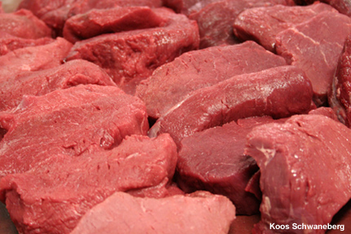

Introducing proteins
Proteins are a diverse group of large and complex polymer molecules, made up of long chains of amino acids
They have a wide range of biological roles, including:
structural: proteins are the main component of body tissues, such as muscle, skin, ligaments韧带 and hair，collagen胶原蛋白
catalytic: all enzymes酶 are proteins, catalyzing many biochemical reactions
signalling: many hormones and receptors are proteins
immunological: all antibodies抗体 are proteins.
Notes:
Photo credit: Koos Schwaneberg

Slide 4

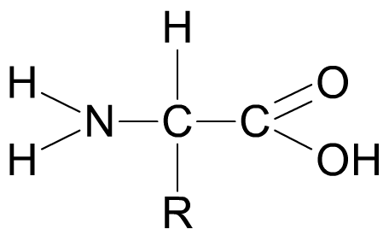
The general structure of amino acids
All amino acids have the same general structure: the only difference between each one is the nature of the R group. The R group therefore defines an amino acid.
central carbon中心碳
amino group
carboxylic acid group
R group侧链基团
The R group represents a side chain from the central ‘alpha’ carbon atom, and can be anything from a simple hydrogen atom to a more complex ring structure.
Notes:
Teacher notes
Students should be made aware that sometimes the R group and H atom from the alpha carbon are sometimes inverted in diagrams (i.e. R at the top and H at the bottom).

Slide 5

The 20 naturally-occurring amino acids

Slide 6
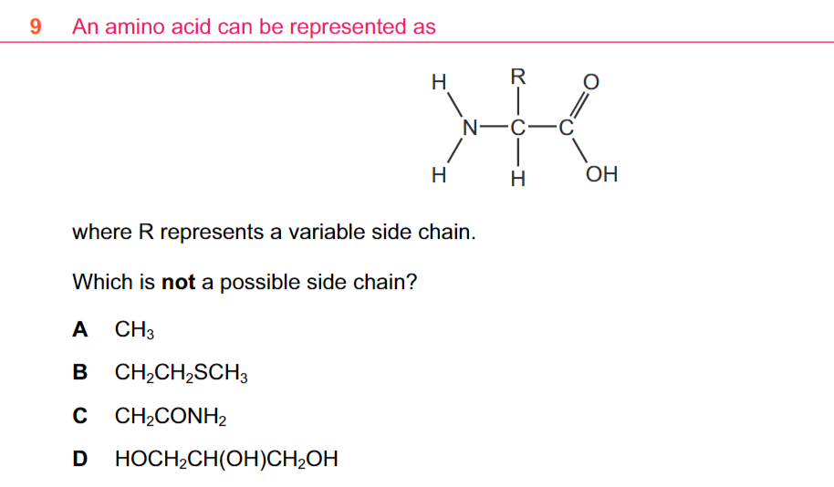
D

Slide 7
Peptide bonds and dipeptides
Notes:
Teacher notes
Condensation reaction and hydrolysis reaction of dipeptides is just the same as for disaccharides, but a peptide bond is formed rather than a glycosidic bond.

Slide 8
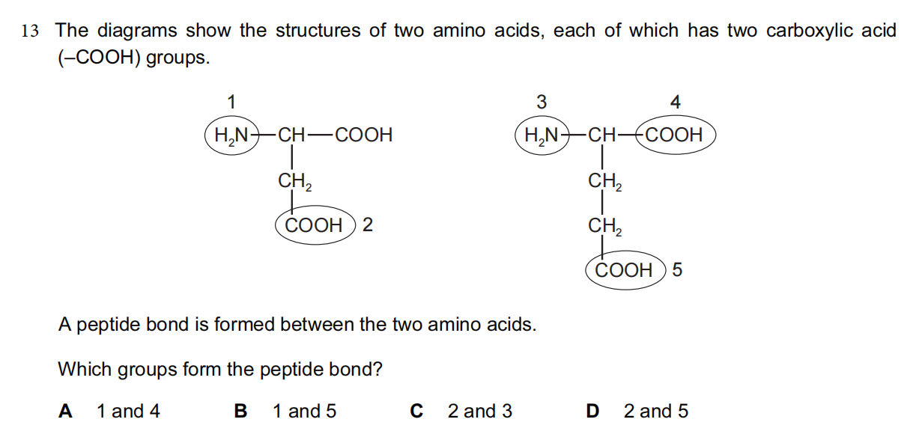
A
Notes:
a

Slide 9
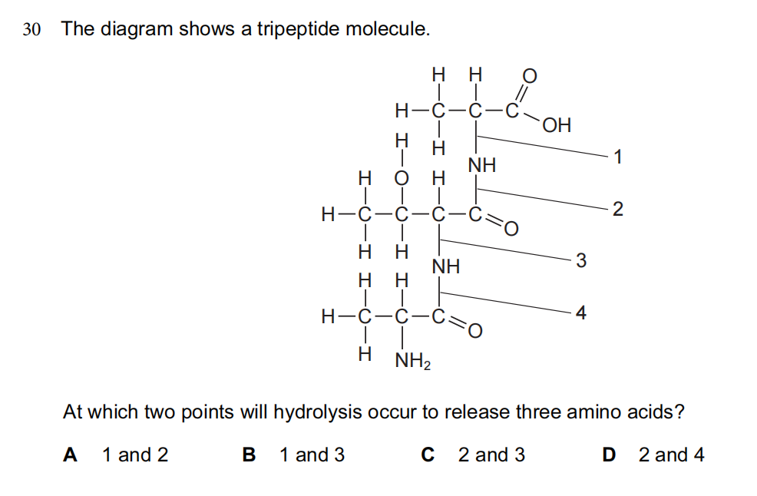
D
Notes:
d

Slide 10
Peptides

Slide 11
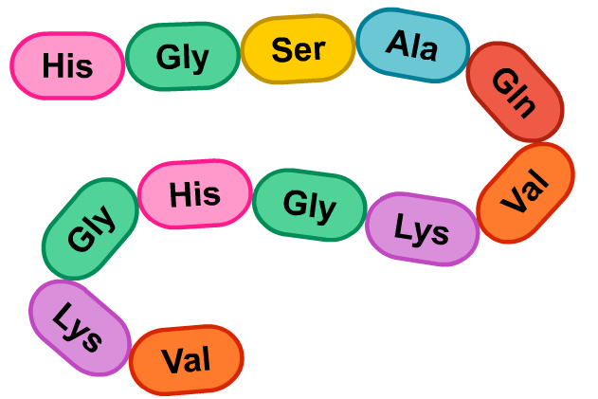
Polypeptides
When more amino acids are added to a dipeptide, a polypeptide chain is formed.
A protein consists of one or more polypeptide chains folded into a highly specific 3D shape.
There are up to four levels of structure in a protein: primary, secondary, tertiary and quaternary. Each of these play an important role in the overall structure and function of the protein.

Slide 12
The structure of proteins

Slide 13
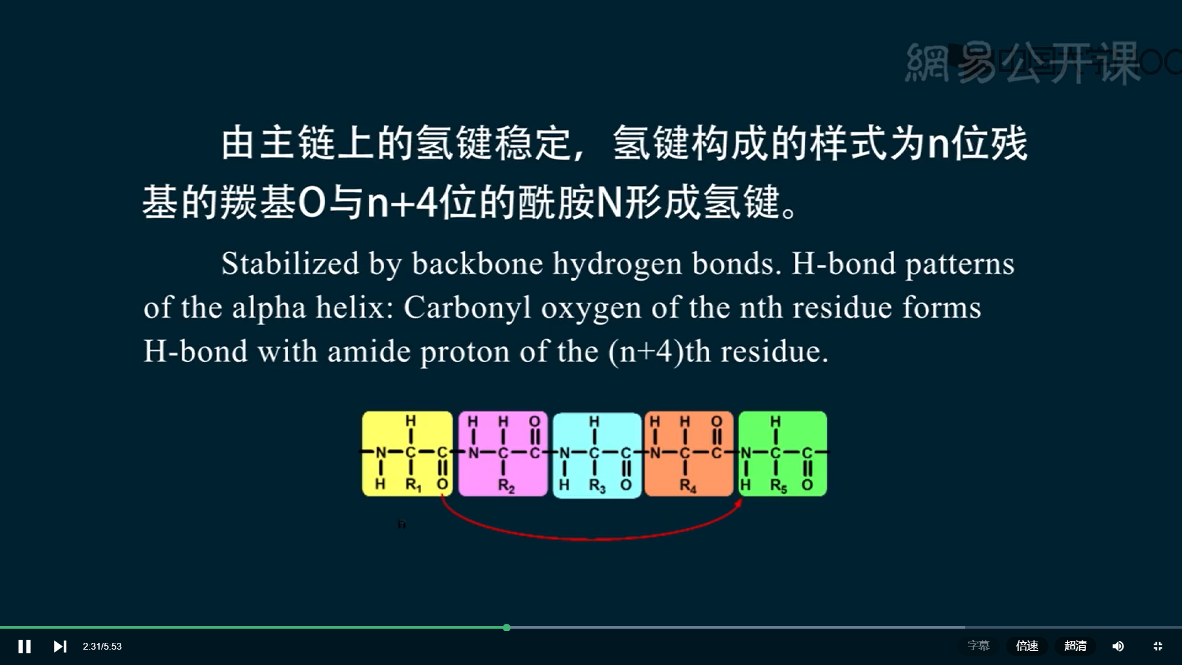
secondary structure
H

Slide 14
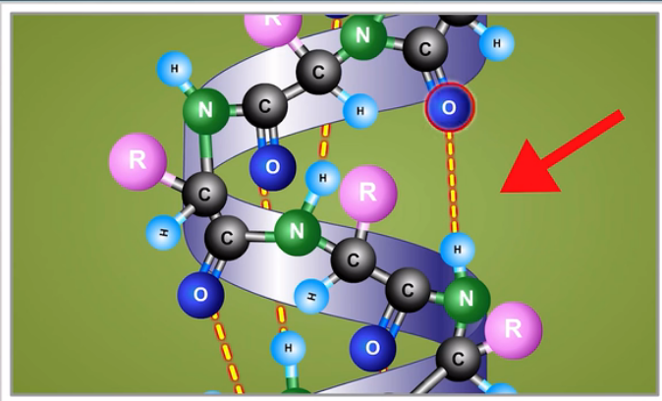
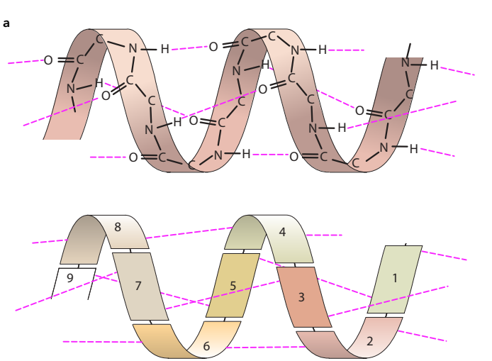
α-helix
α-helix: a helical structure formed by a polypeptide chain, held in place by hydrogen bonds; an α-helix is an example of secondary structure in a protein
α-helix is due to hydrogen bonding between the oxygen of the C-O group of one amino acid(n) and the hydrogen of the –NH group of the amino acid four places ahead of it. (n+4)

Slide 15
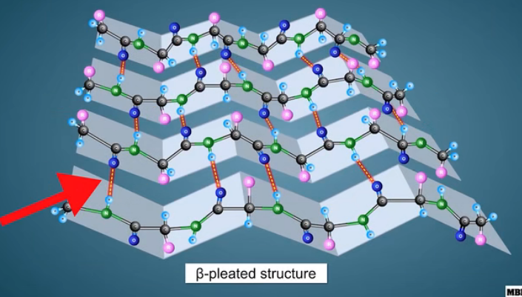
β-pleated sheet
β-pleated sheet: a loose, sheet-like structure
formed by hydrogen bonding between parallel
polypeptide chains; a β-pleated sheet is an
example of secondary structure in a protein

Slide 16

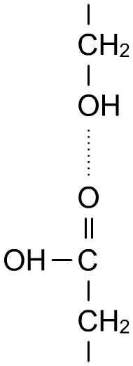
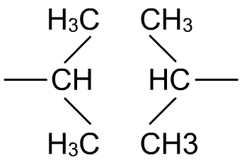
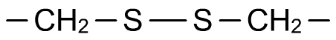
tertiary structure：Bonds in proteins
The 3D shape（globular） of a protein is maintained by several types of bond, including:
hydrogen bonds: involved in all levels of structure.
hydrophobic interactions: between non-polar R groups of the protein.
disulfide bonds: one of the strongest and most important type of bond in proteins. Occur between two cysteine半胱氨酸 amino acids.

Slide 17
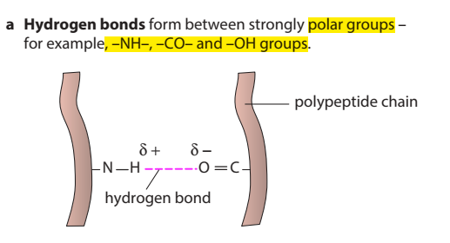
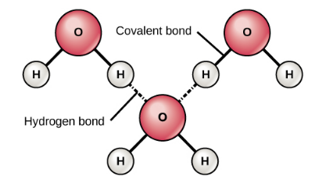
A hydrogen bond is an intermolecular force that forms attraction when a hydrogen atom bonded to a strongly electronegative atom：X-H∙∙∙∙y
polar bond
broken by high
temperatures and pH changes.

Slide 18
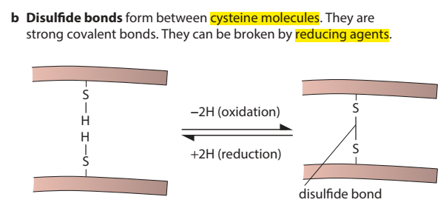
Covalent bonds form when an electron is shared between two elements（non-metal） and are the strongest and most common form of chemical bond in living organisms
Sharing of electrons between atoms of the same kind
E.g. H2, Cl2, O2, etc.
Sharing of electrons between atoms of different kind
E.g. CH4, H2O, NH3, etc

Slide 19
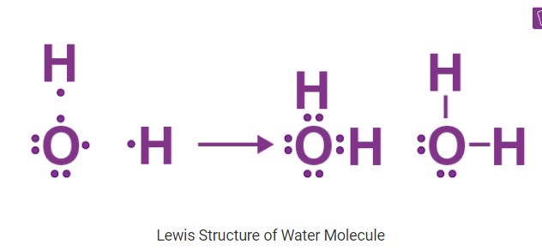

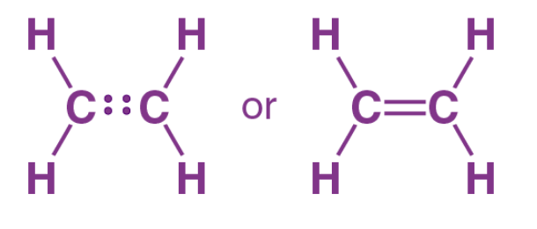

Slide 20
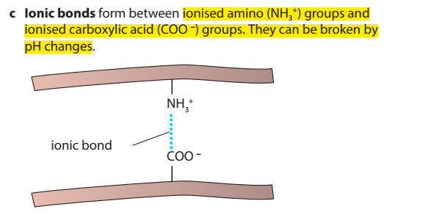
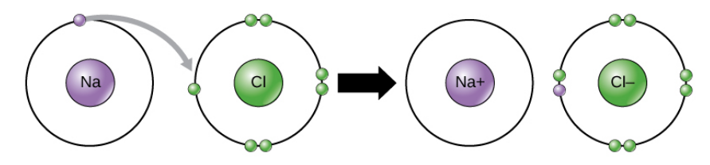
In an ionic bond, one atom essentially donates an electron to stabilize the other atom
Electrovalent bonds are only formed between metals and non-metals.

Slide 21
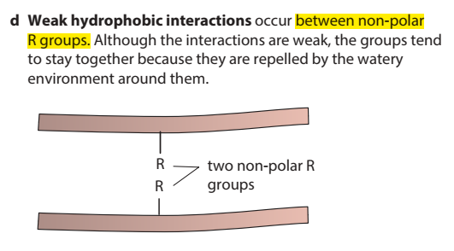
Hydrophobes are nonpolar molecules and usually have a long chain of carbons that do not interact with water molecules.

Slide 22
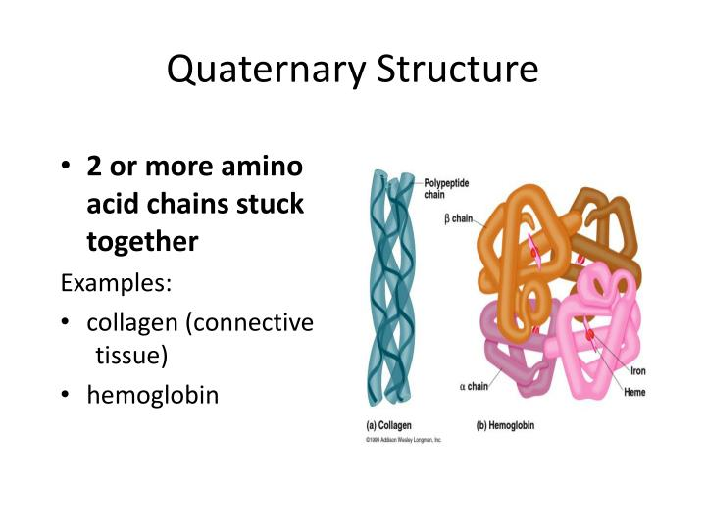

Slide 23
Protein structure

Slide 24
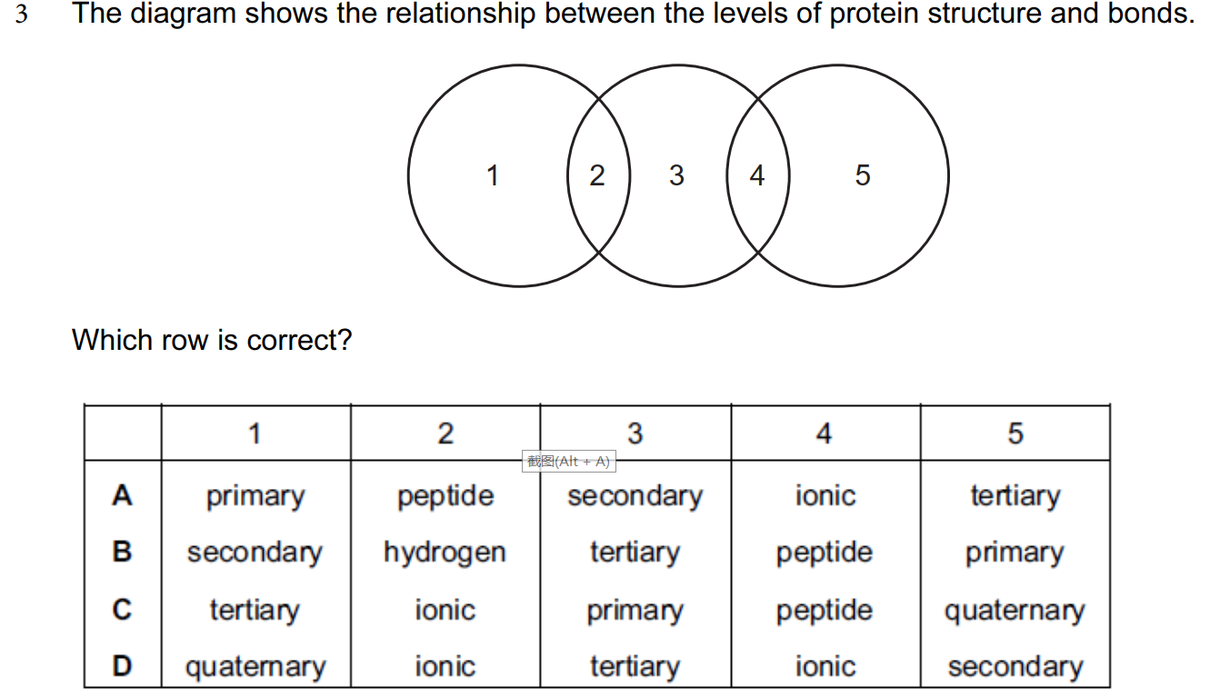
B

Slide 25
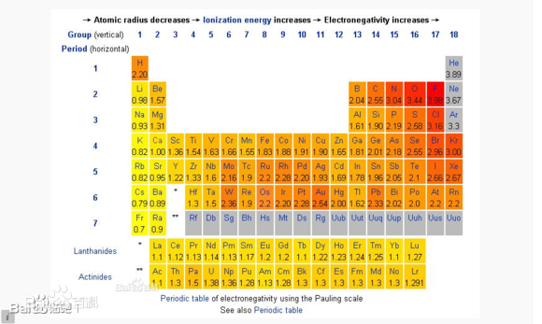

Slide 26
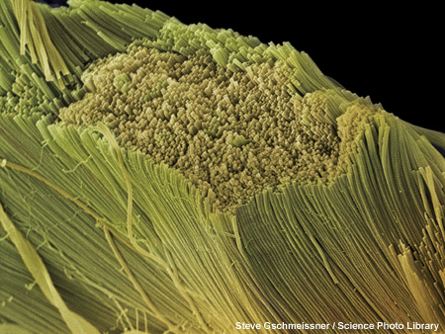
Fibrous proteins纤维状蛋白
Fibrous proteins are formed from parallel polypeptide chains held together by cross-links. These form long, rope-like fibres, with high tensile strength and are generally insoluble in water.
collagen胶原 – the main component of connective tissue such as ligaments韧带, tendons肌腱, cartilage软骨.
keratin角蛋白 – the main component of hard structures such as hair, nails, claws爪子 and hooves蹄子.
silk – forms spiders’ webs and silkworms’ cocoons蚕茧.

Slide 27
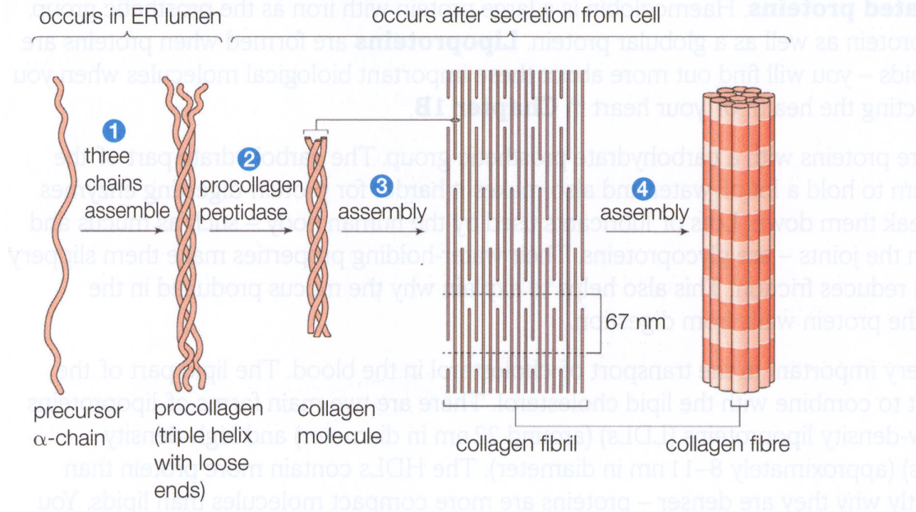
Collagen: a fibrous protein p19
• 3 polypeptides in a helical shape
• helical polypeptides are wound together creating a triple helix（collagen molecule胶原分子）
• collagen molecules are held together by hydrogen bonds
• each collagen molecule interacts with other collagen molecules running parallel to it
• covalent bonds form between them

Slide 28
• these cross-links hold many collagen molecules side by side forming fibrils原纤维
• many fibrils lie alongside each other forming strong bundles called fibres
• collagen is flexible but has tremendous tensile strength

Slide 29
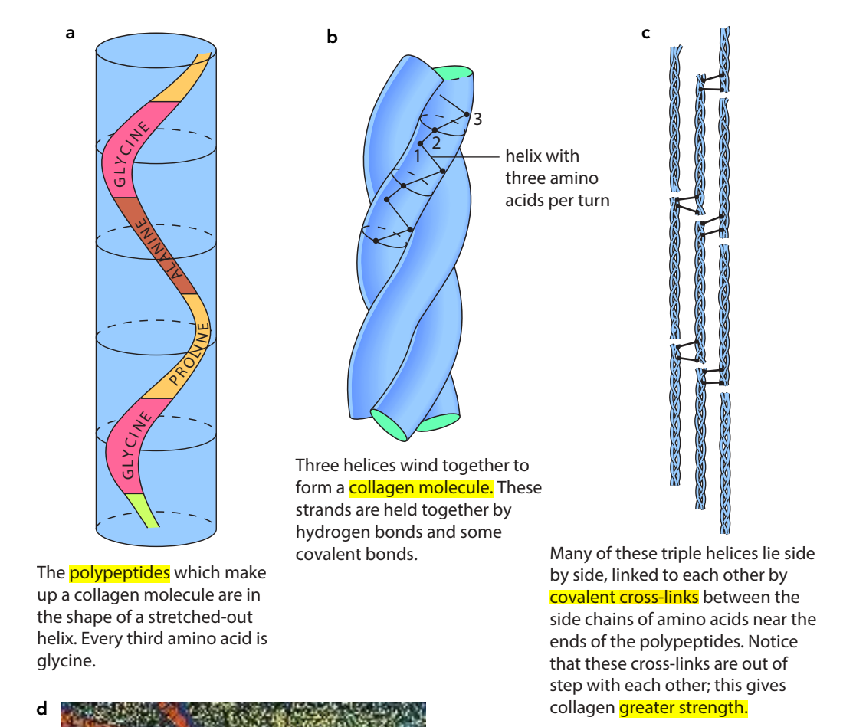

Slide 30
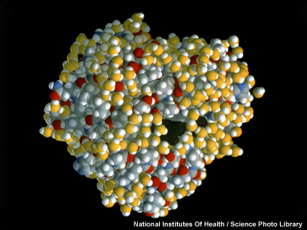
Globular proteins
Globular proteins usually have a spherical shape caused by tightly folded polypeptide chains.
The chains are usually folded so that hydrophobic groups are on the inside, while the hydrophilic groups are on the outside. This makes many globular proteins soluble in water.
transport proteins – such as haemoglobin, myoglobin肌红蛋白 and those embedded in membranes.
enzymes – such as lipase and DNA polymerase.
hormones激素 – such as oestrogen雌激素 and insulin胰岛素.

Slide 31
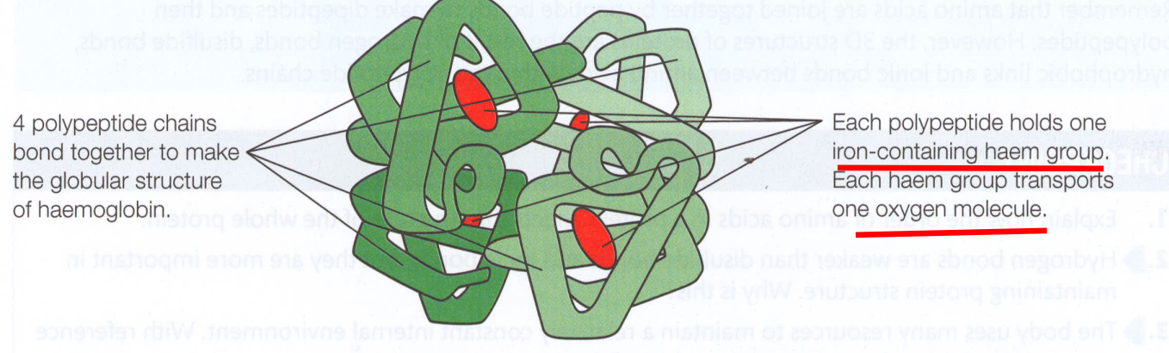
Haemoglobin: a globular protein
• made of 4 polypeptide chains therefore they have a
quaternary structure
• each polypeptide chain has a haem group血红素基 attached
(prosthetic group辅基) to it
• haem contains charged particle of iron
• the haem group is also responsible for the colour of
haemoglobin
• each polypeptide chain can carry one molecule of oxygen
• in total, haemoglobin can carry 4 molecules of oxygen or 8 oxygen atoms

Slide 32
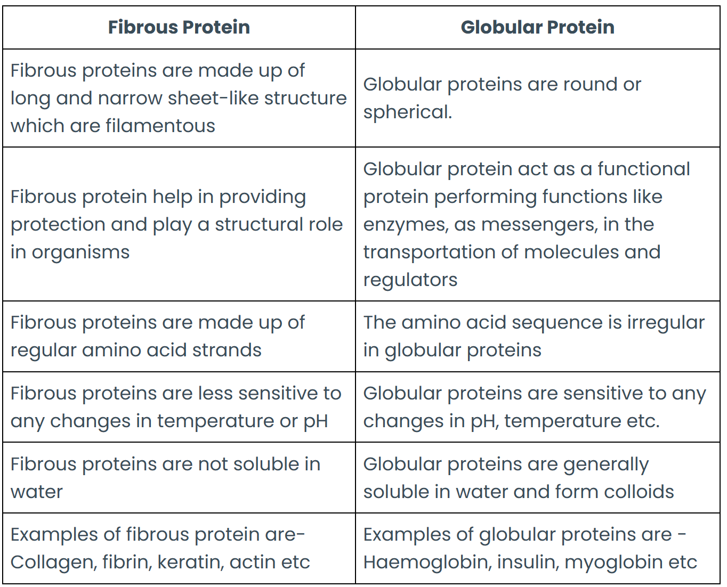

Slide 33
conjugated protein结合蛋白
Conjugated proteins are a type of protein that contains some non-protein elements called the prosthetic group
Lipoproteins脂蛋白 – proteins and lipid
Nucleoproteins核蛋白 – protein and nucleic acid
Metalloproteins金属蛋白 – metal-binding proteins with zinc, iron, or copper（Hb）
Mucoproteins黏蛋白 and glycoproteins糖蛋白 – protein and carbohydrates

Slide 34
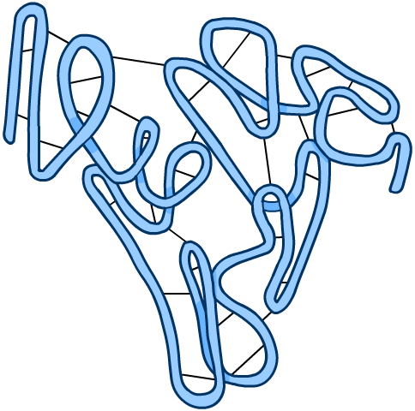
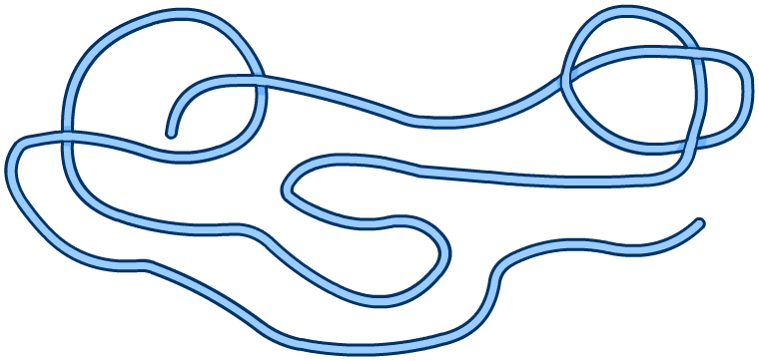
Denaturing proteins denaturation失活
If the bonds that maintain a protein’s shape are broken, the protein will stop working properly and is denatured.
denaturation: bonds broken
Changes in temperature, pH or salt concentration can all denature a protein, although the specific conditions will vary from protein to protein.
Fibrous proteins lose their structural strength when denatured, whereas globular proteins become insoluble and inactive.
Notes:
Teacher notes
The black lines in the left-hand illustration represent the various types of bond maintaining the secondary and tertiary structures of the protein. These are absent from the right-hand illustration, indicating that they have been broken during the denaturation process.
See the ‘Enzymes’ presentation for more information about denaturing enzymes.

Slide 35

Biuret test for proteins

Slide 36
Proteins: true or false?

Slide 37
Notes:
Teacher notes
In ‘Slide Show’ mode, click the name of a section to jump straight to that slide.

Slide 38
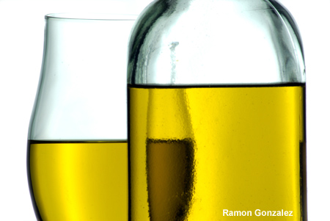
Introduction to lipids
Lipids are a diverse group of compounds that are insoluble（non-polar） in water but soluble in organic solvents such as ethanol.
The most common types of lipid are triglycerides (sometimes known as true fats or neutral fats), but other important lipids include waxes, steroids and cholesterol.
Like carbohydrates, lipids contain carbon, hydrogen and oxygen, but they have a higher proportion of hydrogen and a lower proportion of oxygen.

Slide 39
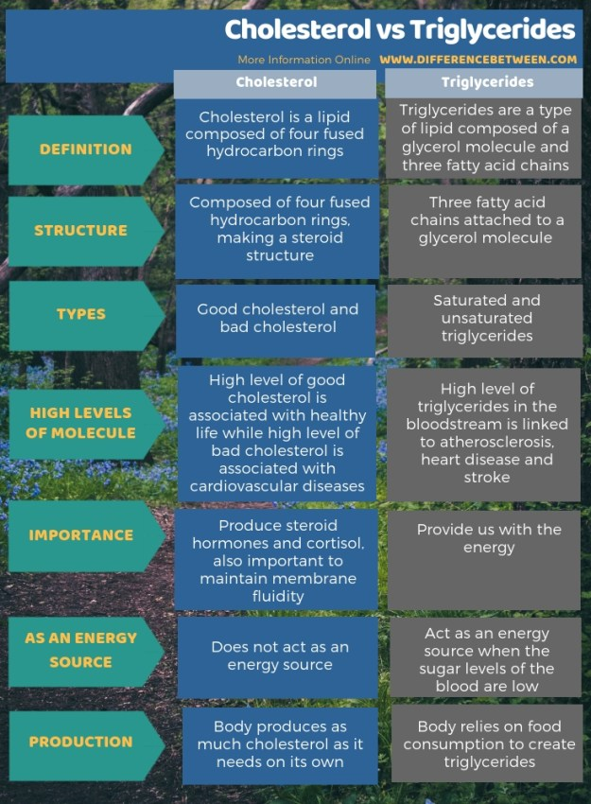

Slide 40
The structure of triglycerides

Slide 41
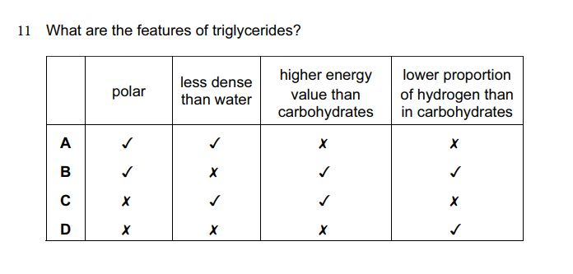
C
Notes:
A triglyceride is non-polar，higher energy value than carbohydrates，higher H proportion than carbohydrates

Slide 42
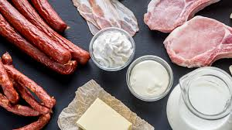
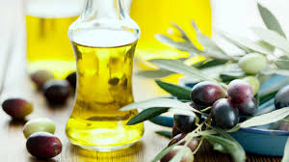
Lipids (Fat and oil)
Fat
Oil
heart.org
betterhealth.vic.gov.au
saturated
solid at room temperature
from animal sources
unstructured
liquid at room temperature
from plant sources

Slide 43
Saturated and unsaturated

Slide 44
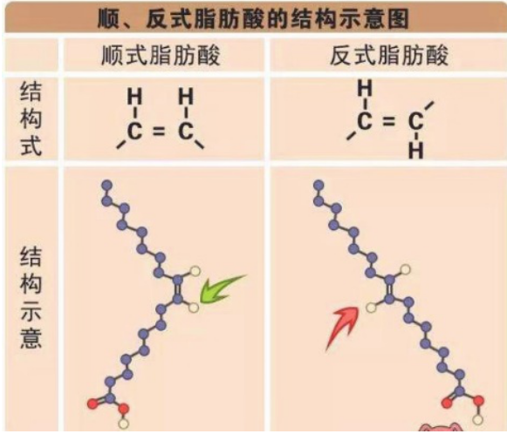

Slide 45
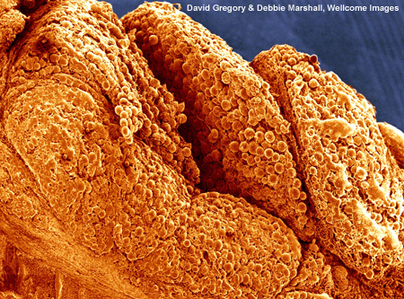
Role of lipids
The major biological role of lipids is as an energy source. Lipids provide more than twice the amount of energy as carbohydrates – about 38 kJ/g.
Lipids are stored in adipose tissue, which has several important roles, including:
heat insulation – in mammals, adipose tissue underneath the skin helps reduce heat loss.
protection – adipose tissue around delicate organs such as the kidneys acts as a cushion against impacts.
As a metabolic source of water

Slide 46
The structure of phospholipids
Notes:
Teacher notes
See the ‘Cell Membranes’ presentation for more information about the properties and biological roles of phospholipids.

Slide 47
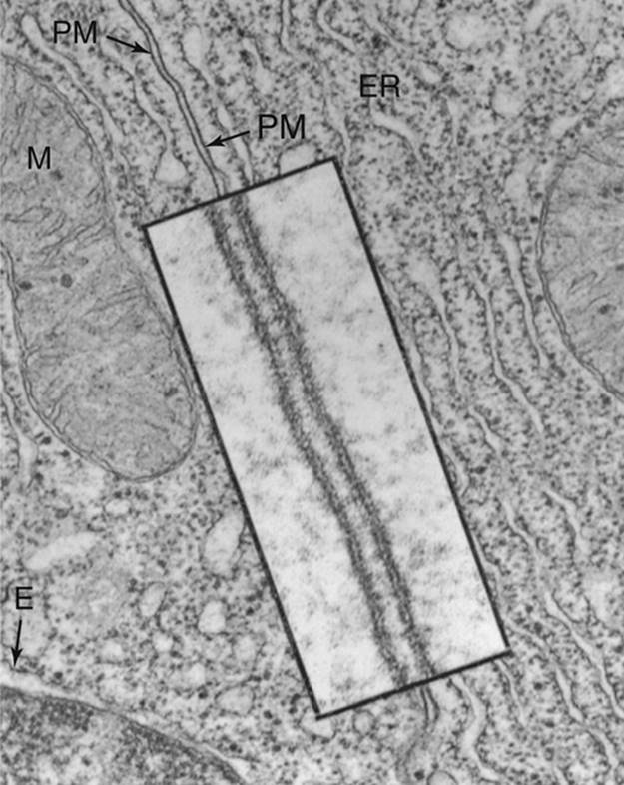

Slide 48
Emulsion test for lipids

Slide 49
Components of lipids

Slide 50
Notes:
Teacher notes
In ‘Slide Show’ mode, click the name of a section to jump straight to that slide.

Slide 51
Glossary

Slide 52
What’s the keyword?

Slide 53
Mystery substance
Notes:
Teacher notes
This activity assumes that students are familiar with the biochemical tests for reducing sugars and starch. See the ‘Biological Molecules 1: Water and Carbohydrates’ presentation for more information about these.

Slide 54
Multiple-choice quiz

